Slide 1
The National Lottery Community Fund
Sported
09/11/2022
Notes:
Welcome
Introductions
Housekeeping

Slide 2
Who we are
John Jatto / Kim Debling – Funding Officer – Sports Regianal Thematic Leads for London & South East Region
North West London
North East London
South London
East London
Essex and Hertfordshire
Solent & Surrey
Thames and Chilterns
East Anglia
Kent
Cross Region
Our regional teams work across six local hubs, covering the Midlands, London, East and South East, North East and Cumbria, North West, South West and Yorkshire and the Humber

Slide 3
Agenda
Our purpose & priorities
Our funding offer
Who & what we can fund
How to apply
Notes:
Overview of agenda & purpose of the session.
Return to our main funding offers after a period of short term emergency funding inc. Lottery & DCMS distribution.
Some slight changes as a result of previous learning, alongside learning and ongoing response to Covid.
Reminder that this isn’t a call to funding and that the demand for our funding is higher than ever. Unfortunately we have to say no to good proposals.

Slide 4
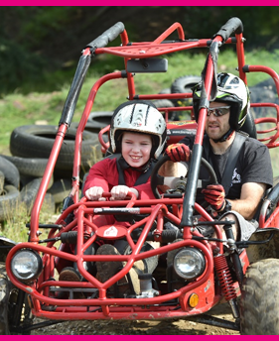
Our purpose
We support people and communities to thrive.
Our goals:
• We support ideas and activities that matter to people and communities.
• We use our funding and relationships to help create stronger, more connected communities.
• We support charities and community organisations across the UK to be vibrant, diverse and active.
Notes:
People understand what’s needed in their communities better than anyone. We listen, collaborate and fund so that good things happen.

Slide 5
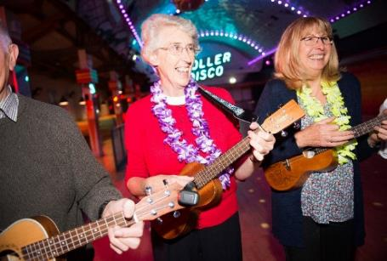
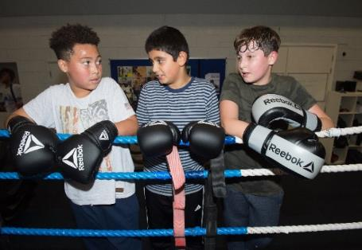
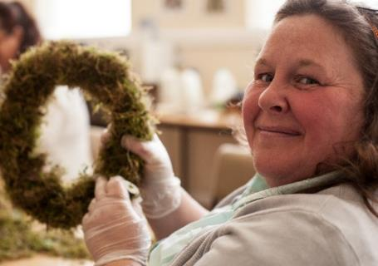
Our principles
People Led
Ensuring the people you work with are meaningfully involved in the development, design and delivery of your work.
Strengths based
Supporting people and communities to build on the knowledge, skills and experience they already have to make the changes they want.
Connected
Demonstrating a good understanding of other activities and services in the community and showing how your proposal will complement these.
Notes:
Although there are many principles which underpin this framework, we mainly consider these three things: is the organisation people led, strengths based and connected
Video link: https://www.youtube.com/watch?v=Uzmc8AnqVIk&feature=youtu.be

Slide 6
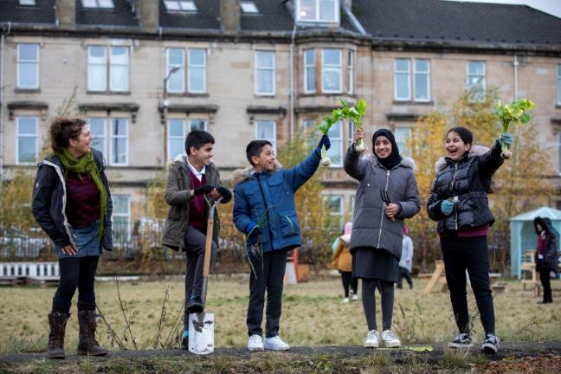
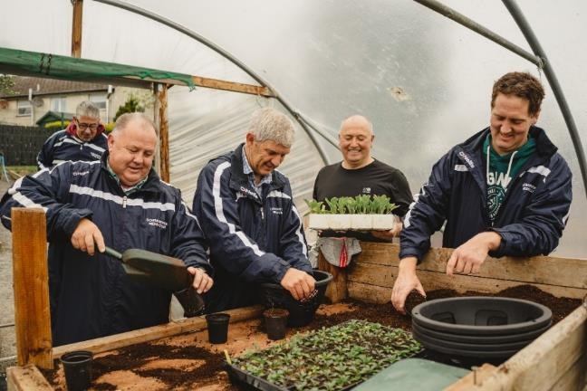
Our approach
Open to all
Flexible
Proportionate
Conversational
Notes:
Communities come in all shapes and sizes - The National Lottery Community Fund is for everyone – so we need to ensure we are reaching out to those that maybe don’t think we are for them. We ensure that our funding is meaningfully informed by lived, learned, and practiced experience, as well as the insight and knowledge that we and others have.
We are a flexible funder. This is a key part of going forward. It always has been a part, but in response to the pandemic we are now even more flexible.
It’s not just what we’ll fund that’s flexible, but our grant making processes have been refreshed and redesigned to be more flexible for applicants, allowing our processes to adapt to the different types of funding that your organisations will need, particularly whilst responding to and recovering from the COVID-19 pandemic.
Therefore we will take a proportionate approach to assessment and grant management based on the scale, size, complexity and amount that you have requested; recognising that it is not a one size fits all process. For example, we wouldn’t expect the same level of detail and information to be provided by a group that wanted £50k over a year as opposed to one that requests £500k over five years.
It’s your local funding officer’s role to assist you, so that you know how much information we need regarding the level of planning required and the amount of information to submit. Our approach remains conversational and relational despite any Covid-19 restrictions – if your idea is a good fit with our priorities we talk to groups so that we can fully understand what you want from us, and if you are successful in being awarded funding we will keep talking to you about how you are progressing with your grants until you have spent all the money.

Slide 7
Our priorities in England
Stronger relationships
We support ideas that bring people together, strengthening relationships in and across communities
Shared and sustainable places and spaces
We support people to shape and sustain the places that matter to them, like a park, community centre or online network
Early action to prevent problems and tackle disadvantage
We support activity that empowers people to fulfil their potential, working to address problems at the earliest possible stage
Notes:
We have three main funding priorities in England which came out of discussions with our grant holders, stakeholders and organisations across the voluntary sector.
We asked them where they think we add most value and what is important for their communities.
These priorities are the same for all England funding.

Slide 8
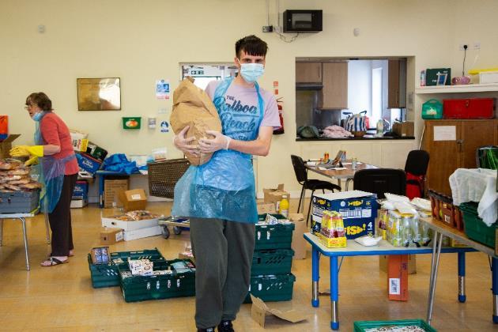
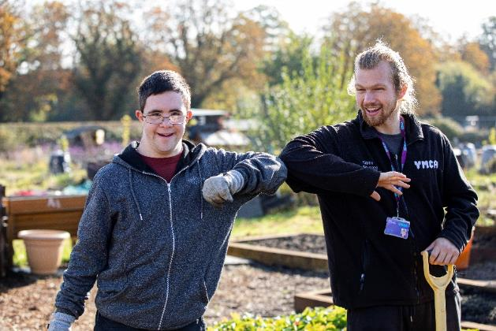
Our priorities in response to the pandemic
We'll continue to support people and communities most adversely impacted by COVID-19.
We want to do more than support organisations to survive; we want to support communities to thrive and grow. Northwestteam@tnlcommunityfund.org.uk
Notes:
Alongside the 3 main England priorities, we will continue to prioritise proposals which respond to the crisis.
We can support groups to:
- continue to deliver activity, responding to the immediate crisis or recovery
- change, adapt and become more resilient to respond to future challenges.

Slide 9
Our priorities in response to the cost of living
We will keep all our funding open and available
We will be flexible and adaptable
Our commitment to people and communities remains a constant
We will work with others to draw on knowledge, insight and foresight
Notes:
We will keep all our funding open and available – all funding portfolios are open for applications whether new or returning. We expect to commit over £75m to support communities on cost-of-living through the next year, factoring in commitments to date and added flexibility in grant making.
2. We will be flexible and adaptable – we know, including from experience during COVID-19, that one of most important things we can offer as a funder is flexibility and agility in our grantmaking approach. We have now made changes to allow greater variations and adjustments in grants underway to reflect cost of living pressures.
3. Our commitment to people and communities remains a constant – as we set out in our Putting Communities First Commitments last year, we will balance responding to the here and now with shaping the future. Demand for funding remains high, and while we can’t fund every project, our funding will remain guided by communities and where our funding can make the most difference alongside others.
4. We will work with others to draw on knowledge, insight and foresight – over the period ahead we will listen and use our grantmaking data and insight to help us – and others – build a picture of what is happening, and make this available to help influence and steer our and others’ approach.
The situation we are responding to is live and developing – please be assured that our approach will be under constant review so that our support remains in step with your needs, allowing you to continue delivering your valuable work and efforts for your communities.
It’s important to say too that the cost of living is a common theme within the many conversations and listening events we are engaging in for our Strategy Renewal. This process began earlier this year and will help shape how The National Lottery Community Fund can best support communities now until 2030.

Slide 10
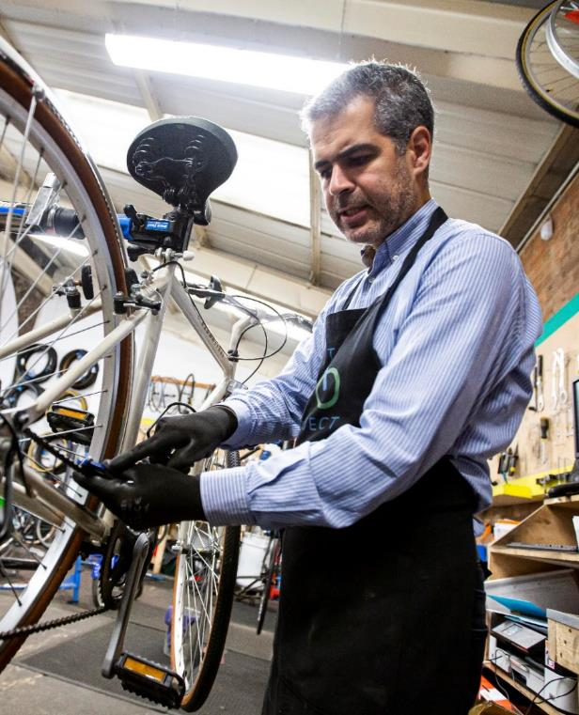
Our funding offer
Have a look at our website for
National Lottery Awards for All
Reaching Communities & Partnerships
All applications should go through
the website unless you have specific
communication requirements.
Notes:
We’ve now re-opened our main responsive funding programmes.
These are the same programmes that operated before our short-term Covid emergency funds – with a few small changes.
All open programmes can be found on our website: https://www.tnlcommunityfund.org.uk/funding/programmes?location=England

Slide 11
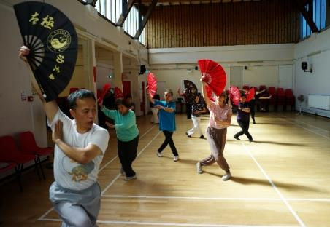
National Lottery Awards for All
Grants from £300 up to £10,000 for one year
Can apply at any time
Only one award in any 12 months, unless you want funding for Jubilee activity
Applications are on-line using a response to 3 questions
Decisions typically within 12 weeks
Notes:
Our most popular programme in England.
Supporting smaller grassroots organisations.
Managed by our teams in Newcastle and Birmingham.
The Awards for All programme is now accepting applications that celebrate the Platinum Jubilee. These should still meet our standard aims and eligibility criteria. Although not a requirement, the strongest projects will also promote relationships across generations or develop the skills and experience of communities or encourage the care of/action in the natural world as part of the celebrations. In order to support your project starting on time applications for funding for Jubilee projects should be received no later than 31 March 2022.

Slide 12
Reaching Communities & Partnerships
We can fund individual organisations or partnerships
Grants from £10,001 or more, running for up to 5 years
Can apply at any time
Applications are on-line with other formats available
Will fund:
Direct costs / project related costs
Organisational development
Core / fixed costs
Capital costs
Notes:
This is managed by our regional teams so the rest of the presentation is more focused on this.
Aimed at organisations and communities with an aspiration to work on larger proposals.
You can expect us to be flexible and responsive to your community’s needs:
whether you need long- or shorter-term funding
whether your request is for a particular activity or to create more fundamental change
whether the funding is to support a single organisation or to bring organisations together.
We can fund for the short-term but also offer long-term support
We can support organisations with activity as well as core costs
We can fund expansion of existing projects as well as the development of new ways of working
We can cover costs for sharing learning and showing impact (demonstrating community cohesion/EDI development/lived experience leadership/establishing partnerships with community stakeholders)
We can support organisations to adjust to the new ‘normal’ and focus on financial, strategic or operational planning/restructuring

Slide 13
Questions

Slide 14
Find out More
Visit our website - www.tnlcommunityfund.org.uk
Call our Advice Line: 028 9568 0143
Email us at:
Londonandsoutheastteam@tnlcommunityfund.org.uk
Northwestteam@tnlcommunityfund.org.uk
Notes:
Also ask your CVS for support and if they can’t help they can signpost you to us.

