Slide 1
Community foundations and the cost of living crisis Rosemary Macdonald CEO, UKCF Sported Webinar, 9th November 2022

Slide 2
INTRODUCING community foundations
A national network with local reach
Community foundations champion the people and organisations making a difference in their local communities by:
encouraging local philanthropy
building local endowment funds
grant making
local convening and matching donors to need
Notes:
The role of a community foundation:
In essence, Community foundations champion the people and the grass roots organisations within their communities through the following key roles:
They encourage philanthropy or giving from a range of donors
They work to build endowment funds which enable them to be resilient and provide a sustainable funding source for their communities for the future. The income from these funds is then used to address needs in their local communities
They are perhaps often best known as grant makers, providing funds from national and local donors as well as their own resources . They provide funding to grass roots community organisations and individuals in need. In this they are cause agnostic covering a broad range of needs (see next slide)
Finally, and perhaps the most understated but vital role, is that they are natural conveners for their communities. They liaise not just with the VCS sector, corporates, trusts & foundations and philanthropists, but also with local authorities and other statutory bodies. This provides not only a wealth of contacts, but also a wealth of knowledge on local need and the means to address that need.

Slide 3
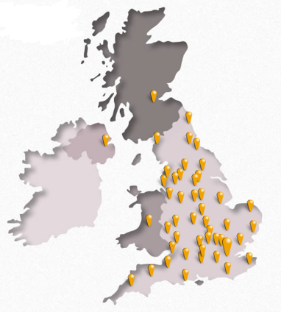
The network in numbers We cover every postcode in the UK
47
47 community foundations + 3 overseas members
Over £l.4 billion given in grants
£816m million in managed endowment
£175m million distributed in 2020/21
Notes:
The Community Foundation Network:
There are 47 community foundations in our network – 3 national foundations representing the devolved nations of Scotland, Wales and Northern Ireland and 44 foundations in England, the majority of these are based along county lines with some developing along metropolitan or unitary authority areas, such as Leeds Community Foundation, Forever Manchester, Heart of England, London Community Foundation and Milton Keynes Community Foundation. Each one is an established charity with their own Boards of Trustees and established Governance. These community foundations cover every postcode of the UK.
We also have 3 associate member community foundations from Jersey, Bermuda and the the Republic of Ireland, which are provided resources in training, and assistance with development of best practice.
Each community foundation shares the key roles mentioned in the previous slide. However, they vary is size and structure in the way they address their community challenges.
The first community foundation was developed in Cleveland Ohio in 1914, with the UKs first one founded in Wiltshire in 1975, these have slowly grown over the years with the newest members being establish about 11 years ago and the average age of most foundations being about 30 years, which is when UKCF was established as the national body with support from CS Mott. Over that period it is estimated that over £1.4bn have been given in grants across the network.
Normally this is around £98m a year, but in the last year it was £175m, with the figure boosted by the distribution of £76m of National Emergency Trust Funding
Between them, the 47 foundations hold approximately £816m worth of endowed assets, which provides greater resilience for the network, enabling foundations to fund vital community programmes from the income generated from these endowments, as well as income from flow through funding provided by local and national programmes. This also means that the network has a stable and long-term outlook and so could guarantee stability and resilience for any long-term partnership.

Slide 4
Issues we tackle in communities
Notes:
Needs Addressed:
Unlike many charitable organisations and national funders, our network is cause agnostic and community foundations will address the needs of their communities across a range of areas. Our work is closely aligned with the UN Sustainable Development Goals which are a universal call to action to end poverty, protect the planet, and ensure that by 2030 all people enjoy peace and prosperity. This wide-ranging agenda allows us to provide funding for priority needs as they arise, and to work with a range of donors to tailor programmes to their specific requirements. All our members are therefore experienced in providing grants to address various areas of need.

Slide 5
SUPPORTING LOCAL SPORT
We have a great track record of supporting community sports organisations both nationally and locally:
Through our national partnership with Made by Sport, community foundations delivered £4.2million of #ClubsinCrisis funding to grassroots sports organisations across the UK
Many community foundations have dedicated funds to support local sports clubs, such as the Suffolk Sports Fund https://www.suffolkcf.org.uk/give/give-together/sports-fund/

Slide 6
A CHALLENGING TIME FOR COMMUNITIES…
The headlines are stark:
Research by the Food Foundation has shown that hunger levels have more than doubled since January. In September nearly 10 million adults and four million children were unable to eat regular meals. This is more than the early weeks of the first lockdown during covid.
Research by the End Fuel Poverty Coalition shows that nearly 11 million households are at risk of being in fuel poverty by April after the Government u-turned on keeping the energy price guarantee fixed for two years. There are currently seven million households living in fuel poverty.
Price inflation is hitting the poorest families the hardest. ONS data showed that by September 2022, the overall price for budget food items (bread, pasta, milk etc.) had risen by 17% in a year.
Notes:
We’re all aware of the challenges facing communities at the current time. There have been numerous research projects to assess the scale of the problem – three are highlighted here, emphasising the challenges around the rise in food prices, fuel costs and the general increase in inflation.

Slide 7
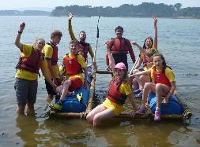
…AND For community SPORTS organisations
The cost-of-living crisis presents challenges for all of us, and local voluntary and sports organisations are no different:
Sharp increases in rental and utility costs
Reduction in financial support from external funders, such as businesses, trusts and foundations, who themselves are feeling the pressures
Impact on family incomes is likely to prevent young people from participating in sporting groups, due to increased travel costs or inability to pay subscriptions.
Notes:
We’re aware from information shared with us by Sported, just how big a challenge the current crisis poses for sports organisations in particular.

Slide 8
HOW COMMUNITY FOUNDATIONS CAN HELP
Community foundations have a long history of running winter campaigns to address fuel poverty, encouraging those who do not need their fuel rebate to donate this to others who need support. This year more community foundations are getting involved, helping individuals and community groups address the cost-of-living crisis in a variety of ways:
Supporting individuals and organisations with fuel bills
Providing emergency grants to community organisations which support vulnerable people to help with higher core costs
#DonateThe Rebate
Find your local community foundation here: https://www.ukcommunityfoundations.org/our-network
Notes:
Community foundations are responding to the crisis as best they can, building on years of experience in running campaigns to help communities weather the storms of high fuel costs over the winter months. This year they are extending their efforts to ensure that as much help as possible reaches the people and places who need it most. Please do use our website search facility to find your local community foundation and understand what they can do to help your organisation.

Slide 9
For further detail or questions please contact: Rosemary Macdonald, CEO rmacdonald@ukcommunityfoundations.org https://www.ukcommunityfoundations.org

