Slide 1
Social Media Marketing
A quick-start guide to getting it right online

Slide 2
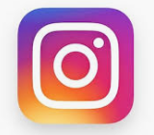
The Big Five
Facebook – Informal dinner party
Twitter – House party. Quick, easy
Instagram – Student night. Fast paced, cheerful and full of selfies
LinkedIn – Business club networking
YouTube – video only - for all occasions – depends on what you’re posting
Which one is right for you?
Girls had a more positive perception of themselves, including feeling less of a failure and being happy with who they are

Slide 3
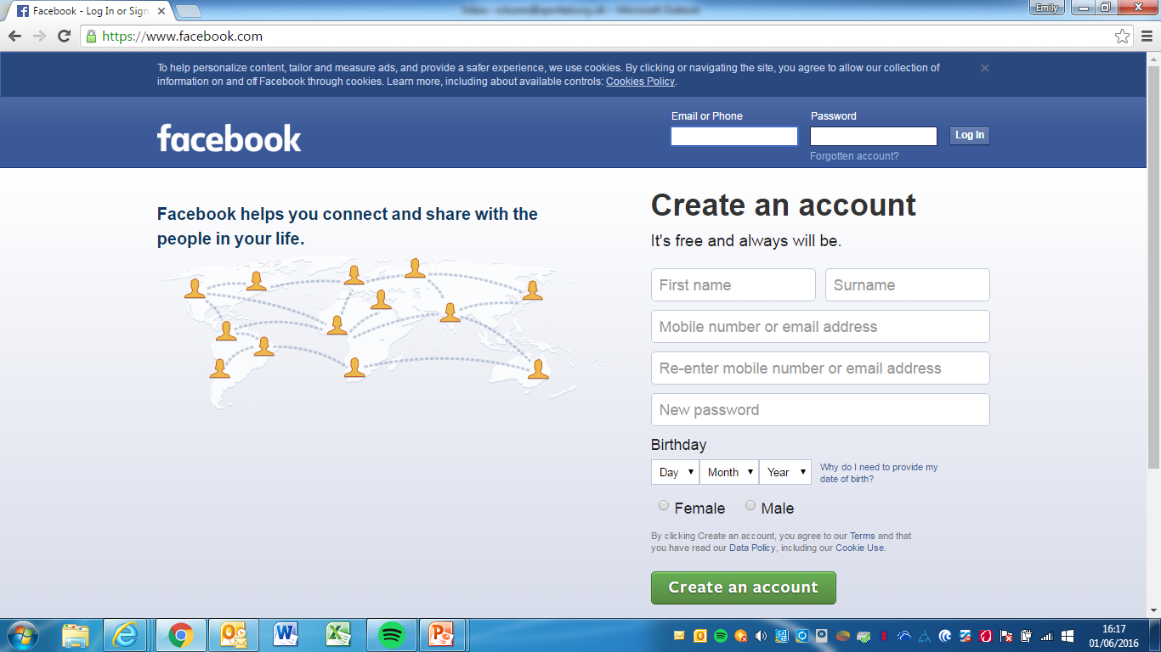
Facebook
Facebook has around 1.65 billion monthly active users and is one of the most popular platforms, not only for personal use but business as well. For businesses, Facebook is a place to share photos, updates, and general news with those who follow or “like” you.
Fans of your business come to your Facebook page to find out what’s going on with your company, see pictures of what’s going on, or explore events.

Slide 4
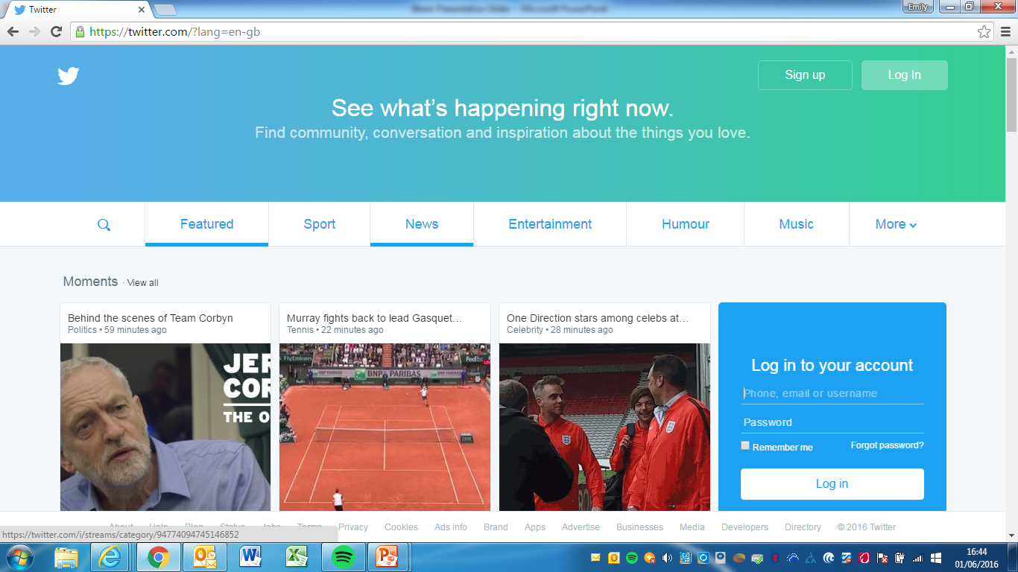
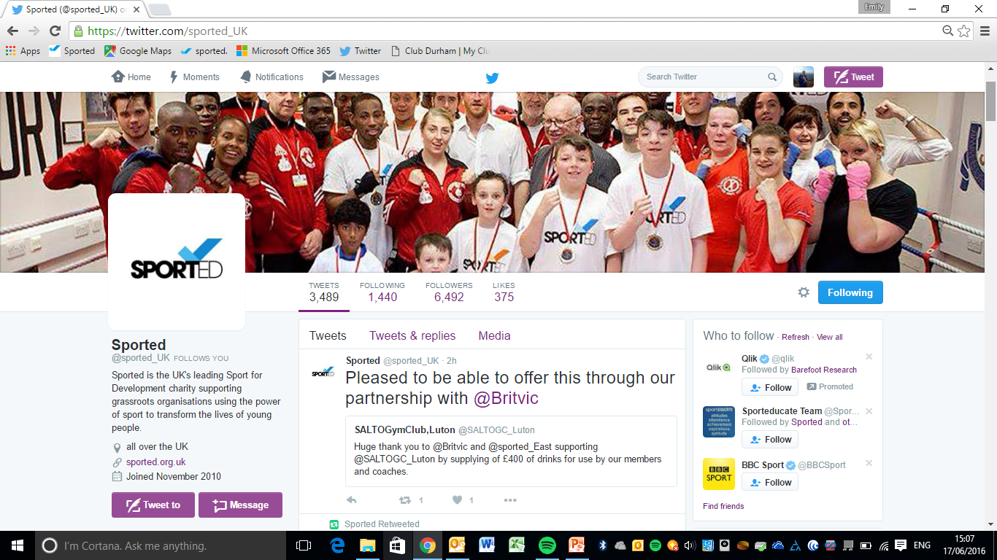
Twitter
Twitter is fast-paced, concise, and easy way to connect with your audience.
With over 310 million registered users (and growing), Twitter is a sea of information of 140 character or less content waiting to be read, clicked, followed, and re-tweeted.
Twitter generates over 175 million tweets daily
Usernames are used for individuals or organisations @Sported_UK
@Sported_NE
@Sported_Vols

Slide 5
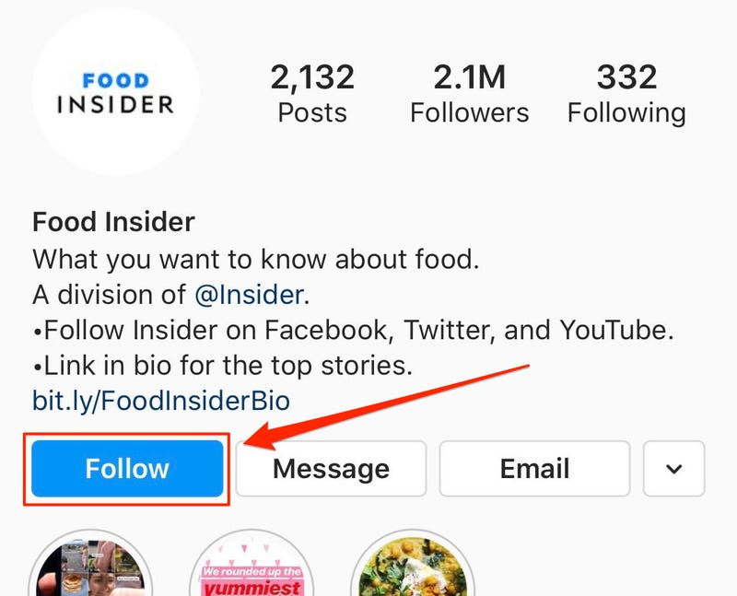
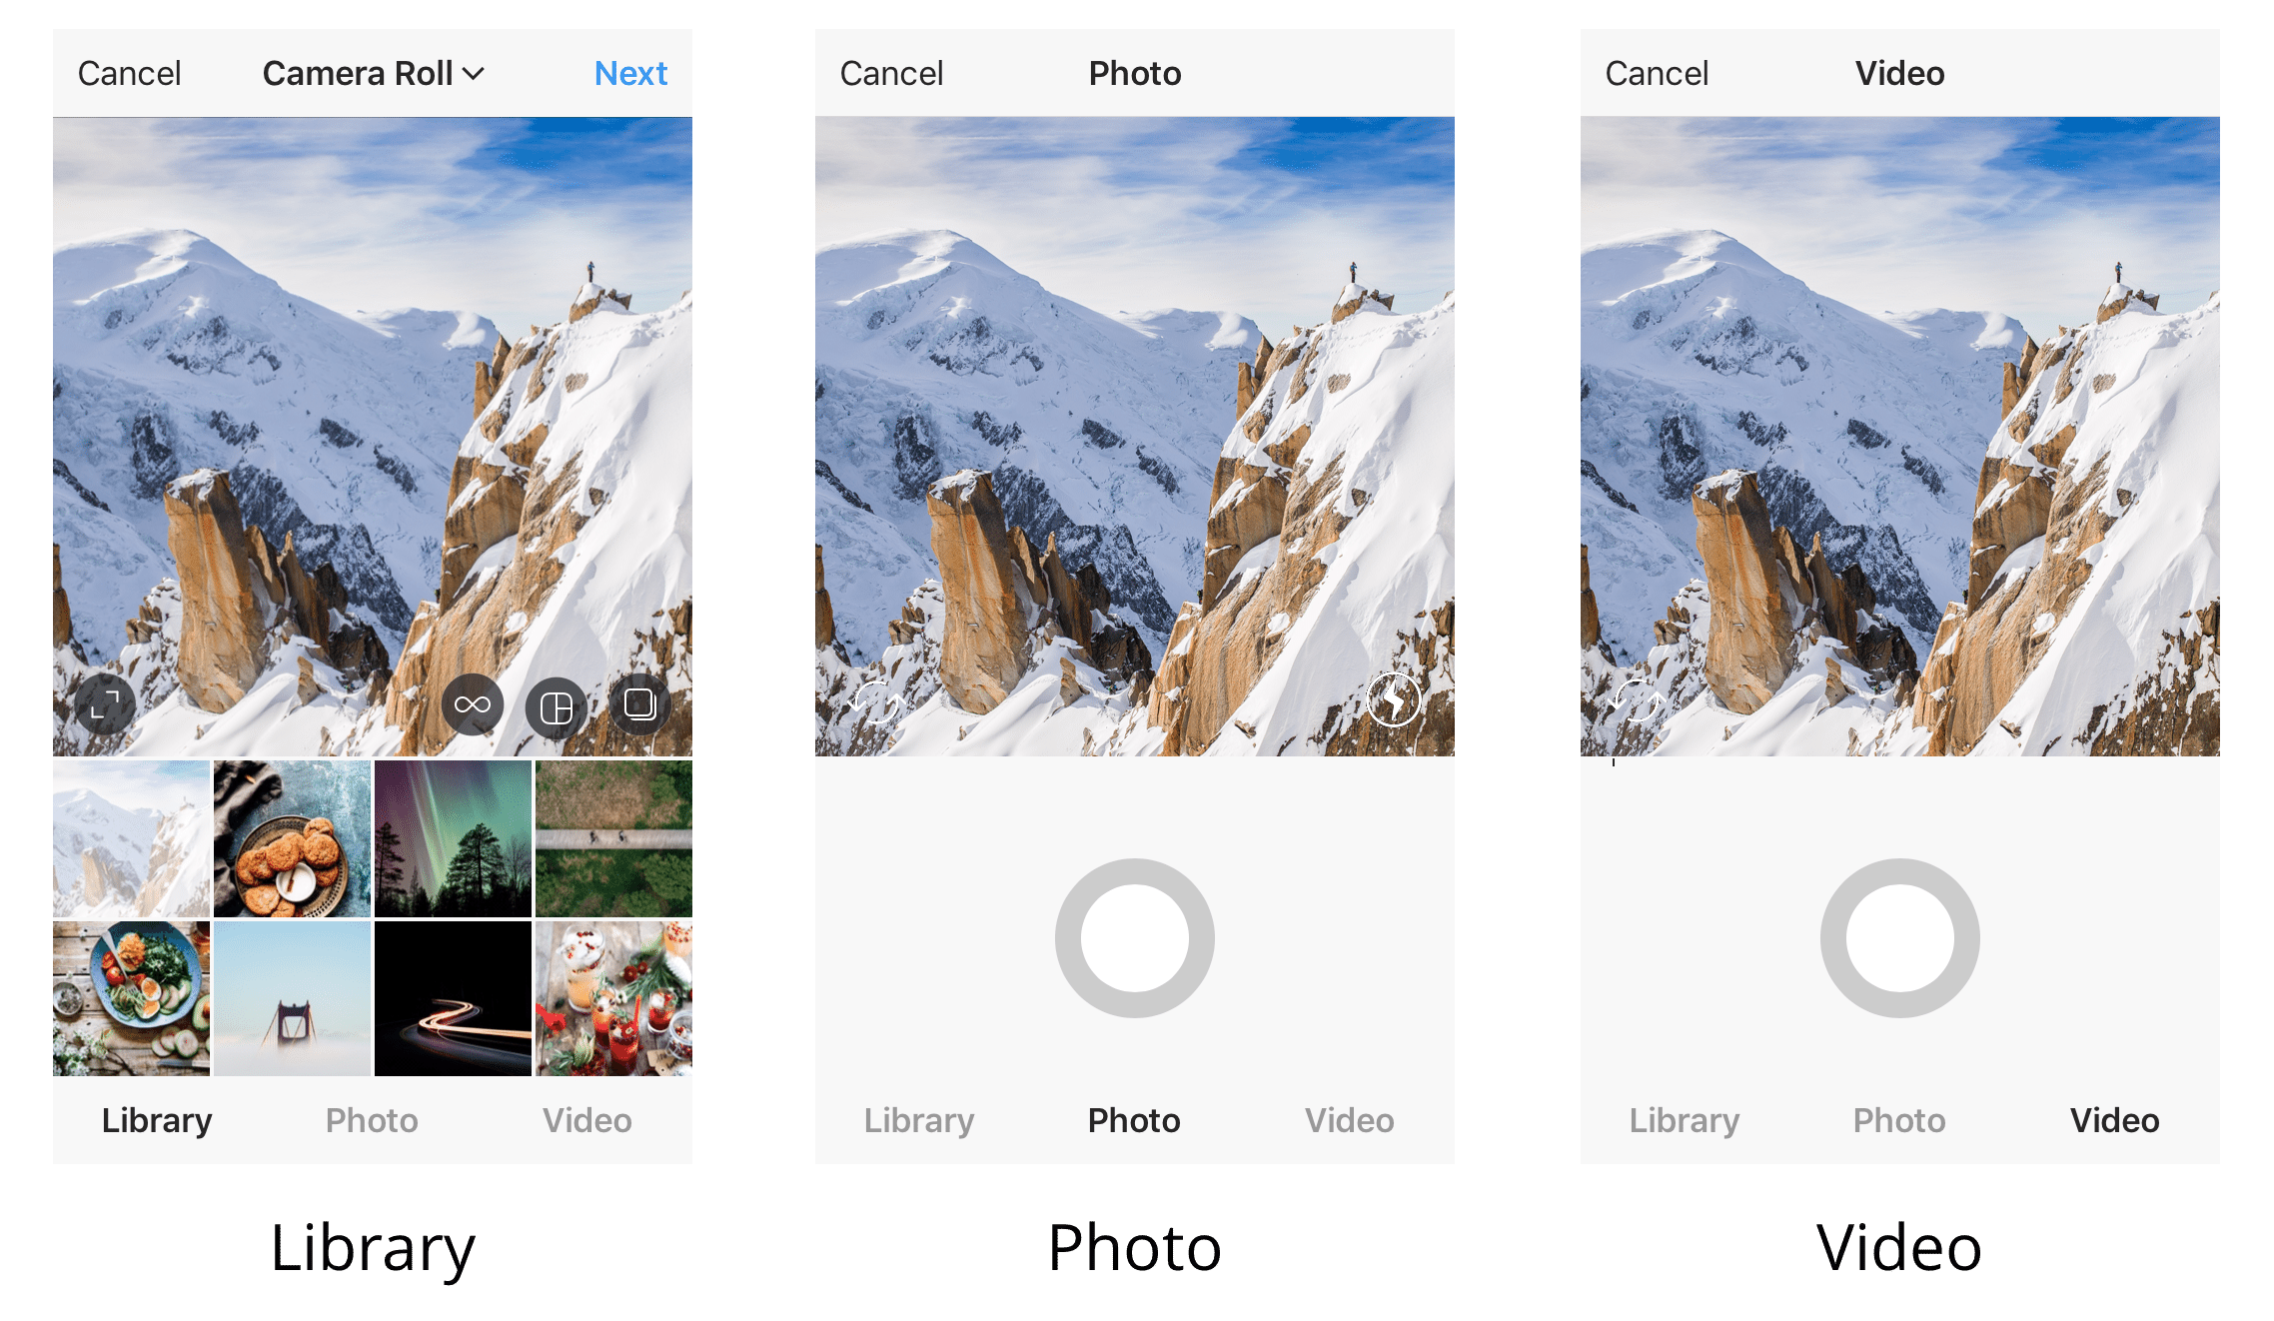
Instagram
Instagram
popular for young people
All about pictures and stories
Instragram is owned by Facebook so you can share content between the two platforms. With over a billion accounts, Instagram is great for expanding your reach using images and stories.
Owned by Facebook so can link content between the two (https://influencermarketinghub.com/how-to-cross-post-to-instagram-from-a-facebook-page/)
Designed to be used on mobiles only – great when you’re out on the pitch or at activities
https://www.themeboy.com/blog/instagram-sports-team-marketing/
http://socialnsport.com/tips-for-instagram/

Slide 6
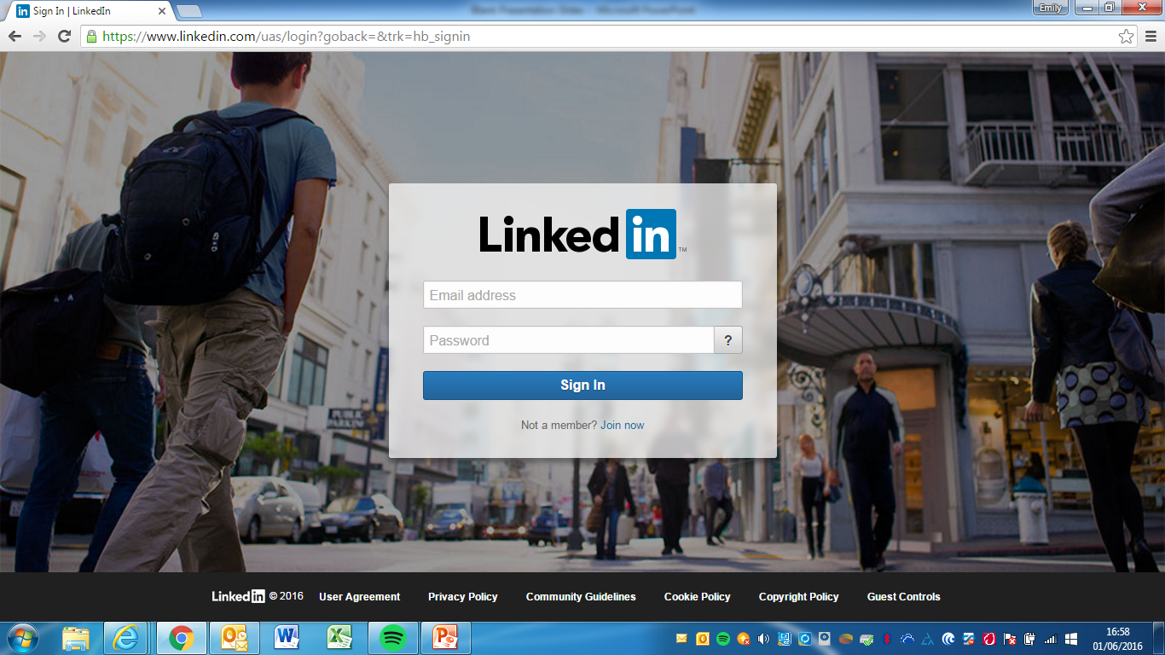
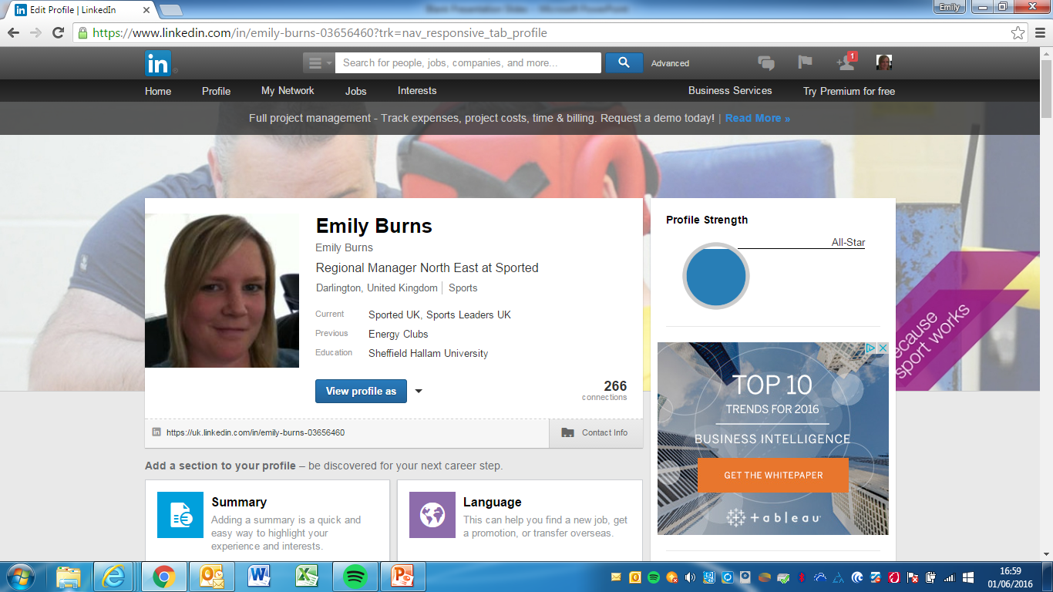
LinkedIn
LinkedIn is different from the rest of the social media outlets because it’s specifically designed for business and professionals.
It’s mainly used to showcase job experience and professional thoughts.
There is a lot less conversation happening directly on LinkedIn pages then there is on other social media marketing profiles.
However, it’s a great place to publish professional articles or posts.

Slide 7
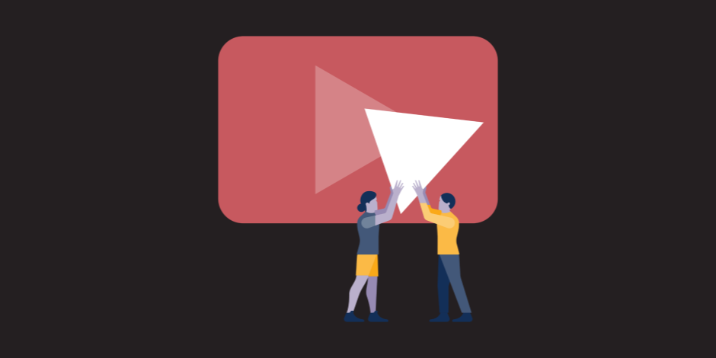
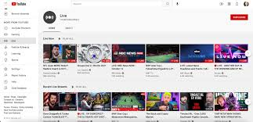
YouTube
Include target keywords in your titles and descriptions
Saying your target keywords in your video can help YouTube better understand what your video is about.
YouTube uses engagement (likes, comments, views) to help determine where videos rank in its search results
Use categories to help YouTube get a better understanding of who to show your videos to.
You can also add tags to your videos to give YouTube more context about your content
YouTube is a free video sharing website that makes it easy to watch online videos. You can even create and upload your own videos to share with others.

Slide 8
Hints and tips

Slide 9
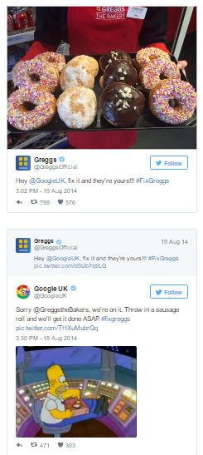
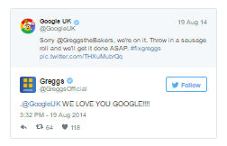
Tone of voice
Think about the different tones of voice you see on social media. People don’t go there for sales pitches or corporate stuffiness!
An example of social media done well – Greggs and Google
The brands and companies that do social media the best are the ones that give personality. Engage with your customers. Don’t be afraid to inject some humour – people want to be entertained! Be polite, but fun too. Subtle sales messaging is the key here!
People who engage with you are more likely to share your content – increasing your exposure.
Corporate speak

Slide 10
Images and video
You know what they say…. A picture paints a thousand words.
Research shows that social media posts using visual content are more than 40X more likely to get shared on social media than other types of content (Hubspot, 2016).
That’s huge!
Posts using video perform even better.
However, remember that images and videos should be relevant, to the post and to your brand.

Slide 11
Increase in followers and likes
People message you and give you content to use
People tag their friends on your posts
People share content
Get technical! (Twitter analytics, Facebook insights etc)
Is it working?

Slide 12
And another thing…
Social media is hungry – think about how much time you have to do this. Who could help you?
The more information you include in your profile, the more traction you’re likely to get (e.g. include profile pic)
Who is in charge of your “brand”?
Tools to manage multiple platforms (hootsuite, buffer etc)
What key supporters or partners do you already have who you can ask to RT or share your posts
Consent for videos and pictures

Slide 13
Do’s and Don’ts
Liking your own posts
Neglect
Share too much
Connect with everyone
Forget to Network
Privacy Settings
Don’t be spammy
Not responding at all
To much automation
Know your customers
Be active but don't over-do it
Time does matter
One voice
Share
Be original
Customer Service
Having a personality
Understanding which social media platform(s) are best for their business

Slide 14
Any questions?

