Slide 1
Community Involvement and consultation
Evidencing local need and demand to funders (among others …)

Slide 2
Local Govt Assocn (LGA)
Being consulted by the Council/ Govt etc ….
Consultation is technically any activity that gives local people a voice and an opportunity to influence important decisions.
It involves listening to and learning from local people before decisions are made or priorities are set.
Tip: ALWAYS ask what the scope for change is – saves time/ energy

Slide 3
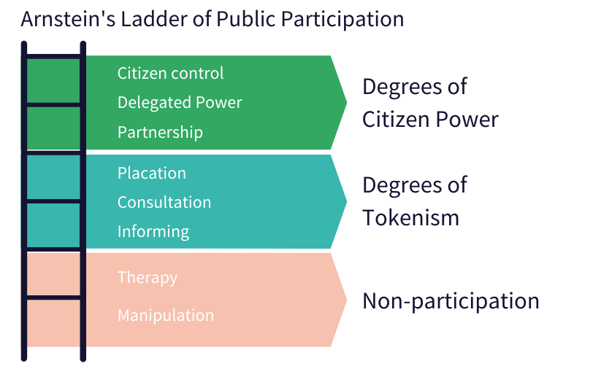
Power
Notes:
Lack of transparency / openness/ accountability – public sector values
Placation – positive aspects only
Manipulation – steering towards desired result
Therapy – use of subtle means
Information – fine to do this but be clear about it .

Slide 5
So…Community Consultation for funding and community development …
Listening to and learning from communities before developing/ changing a project
Community involvement – there must be scope for change

Slide 6
What do funders ask about local need?
Community involved in project development
Evidence it’s needed & in demand
Connectedness – with community, other orgs ( duplication?)

Slide 7
Apart from funders asking why bother ?
Looking …
Inwards: How are you doing : Review, evaluate - new/ stop/ expand = relevant services
Forward : Planning – funding strategy, business
Outward : marketing, publicity, PR, new perspectives , Connectedness

Slide 8
Asking the community - In a nutshell
Clarity
What do you want to know
What data you need to collect – no more no less
Is it biased – the questions / inclusion
Up to date
Notes:
Most orgs collect too much info ,
consult too much about the same issue again and again – consultation fatigue
Never feedback
No incentives

Slide 9
Asking the community - Bit more detail …. Essentials
Clarity : What do you want to know ?
Keep it simples
Consult current and potential beneficiaries
Timing: plan ahead , best times for community; start/ end dates
Accessibility “Easy to overlook” communities
Documenting : quantity & quality
Open questions – unbiased
Creativity – ask community/ young people for ideas
Cost – doesn’t have to be expensive ; staff vol time ; signers – worth it .
FEEDBACK – even if unsuccessful
Ongoing engagement – comments / complements/ feedback box

Slide 10
Methods
Increasingly , videos
Surveys - online , face to face
Stories , case studies ( typical of community)
Events : yours / others; focus groups , formal consultation meetings , informal ( focused) chats
Out and about : walkabouts, door to door, community groups/ gathering places
Incentives / enjoyment
Commercial sector – knowing your consumers/market need : constant feedback requests – crucial to sustainability .

Slide 11
Cue the Qs …. Quantitative + Qualitative
Quantity : eg number of participants, ages, multiple choice responses
Y/N
Quality : thoughts, comments opportunities after tick box questions experiences – case studies , stories , feedback
Open questions - unbiased responses
Eg “how do you feel about …” “ what do you think about” “what do you like best/ least” “what could be better” “ what activities would you like to take part in” “have you any ideas about…”
Best community consultation – both

Slide 12
Answering funders questions about need / demand
Often seen: “ We consult the young people regularly and they agree that …”
Specify :
Date/s
Methods of consultation ( eg survey : D2D, at activities, walkabout…)
Questions you asked
Who took part
Responses - total number / % …

Slide 13
Planning tool
Problem to solve Duplication / complementary ? y/n Project partner/s? Aim of consultation Deadline for consultation: Resources we have : ££ ___ staff ___ vols___ venue ______ Lead person
Who | Inclusion Access needs | Method | Date / time/ location | Quantitative Info to be collected : eg numbers/ multiple choice responses | Qualitative: info collected eg quotes/ comments | Analysis summary – date of feedback to the local community | Evaluation
Notes:
Basically a summary of good practice

Slide 14
Storing & analysing
Databases eg Access
CRM – investment / tailor
Excel is good – easy to interrogate ( don’t merge boxes!)
Physical and Digital files – written info , videos,
Store as you go along – complaints and complements – patterns can emerge

Slide 15
Sported Training - An introduction to Co- Production
June 14th 6pm – 8pm Co-Production training
Increasing number of funders require groups to develop projects in conjunction with their participants
The Co-production training will
what it is,
how to do it
how to evidence it

Slide 16
Resources
Sported :
Re-engaging young people
Measuring your impact https://thehub.sported.org.uk/resource/measuring-your-impact.html
Others
Toolkit - nice format
Step by Step Guide to Generating Evidence
Herefordshire Council
Local Govt Association - worth a look
Consultation toolkit Northampton Council
Dover Council Consultation toolkit

